Slide 1
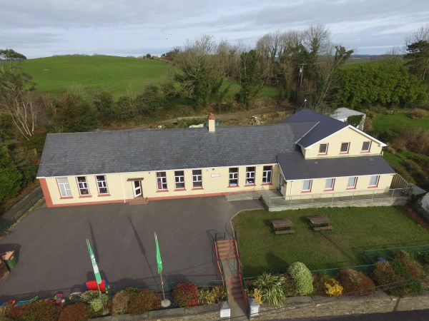
Ballinacarriga NS
Table Quiz
Saturday 26th Nov.
Tots Pub, Ballygurteen at 7.30pm
Tables of 4:
€40
Prizes on the night

